Slide 1
Desktop Object Identification and Tracking
Kevin DuCharme &
Max Li
Notes:
This PowerPoint Template includes a series of slide masters with predefined layouts and color schemes for formatting slides
Slide Masters are displayed when you right click on a slide and select Layout from menu

Slide 3
Motivation
First level bullet text, Verdana 24pt
Line spacing 0.95, before paragraph 12pt
Left justified
Sentence case
First level bullet color is accent1
Second level bullet Verdana 20pt
Line spacing 0.95, before paragraph 6pt
Third level
Third level
Fourth level
Notes:
Robots are quickly becoming a staple in everyones living room, with the likes of Alexa
and Google Home acting as virtual assistants that aid in everyday tasks. These rst-wave
household assistant robots primarily focus on verbal interactions, and are xed to one
location. Recent developments have started to branch out, with computer vision bringing a
whole new domain of possibilities to these devices. Jibo, a robot out of the MIT Media Lab,
is an example of that. Jibo is a natural extension of the Alexa concept, acting as a mobile
home assistant. Computer vision is not only used to navigate, but also for the recognition
of common faces in the household, among other functions. While the goal of this project
is not completely in line with Jibo, it represents one of the many ways that these personal
assistants can intersect with computer vision.
The main motivation behind this project is the struggle of finding items on a heavily used
desk. On an active workbench, tools and other useful items are frequently getting picked
up, used, and placed down somewhere else. While good standard operating procedures will
make sure all the parts end up where they're expected to be, it's very easy to quickly lose
track of items.

Slide 4
Introduction
First level bullet text, Verdana 24pt
Line spacing 0.95, before paragraph 12pt
Left justified
Sentence case
First level bullet color is accent1
Second level bullet Verdana 20pt
Line spacing 0.95, before paragraph 6pt
Third level
Third level
Fourth level
Notes:
The goal of this project is to start the foundation of a lab assistant robot that has the
capability of tracking common items found on a workbench in pseudo real-time. When a
user queries the robot, it should be able to tell the user where a specic tool is, in a way
that would make sense to the user. Initially, the objects being identied would come from
a preset bank of objects that have been pre-trained. However, the end product will likely
have to be trainable on new objects by the user.
For this project, the main topic of focus is object tracking. After all, the rest of the
features are both fairly dicult (and thus time-consuming), and out of scope of the computer
vision task. As such, the goal is to be able to detect a number of dierent objects, identify
what they are, and track them as they move across a camera.

Slide 5
Single Shot Detectors
Theme Fonts:
Verdana (heading)
Verdana (body)
Drawing Style Default:
Sample
Sample
Sample
Text Box Default:
Verdana 16pt
Color: Black
Align: Center Line Spacing: Multiple .95 Space Before: 6pt
For labels only – use layout placeholders for bulleted lists
Line Style Default:

Slide 6
Transfer Learning
First level bullet text, Verdana 24pt
Line spacing 0.95, before paragraph 12pt
Left justified
Sentence case
First level bullet color is accent1
Second level bullet Verdana 20pt
Line spacing 0.95, before paragraph 6pt
Third level
Third level
Fourth level

Slide 7
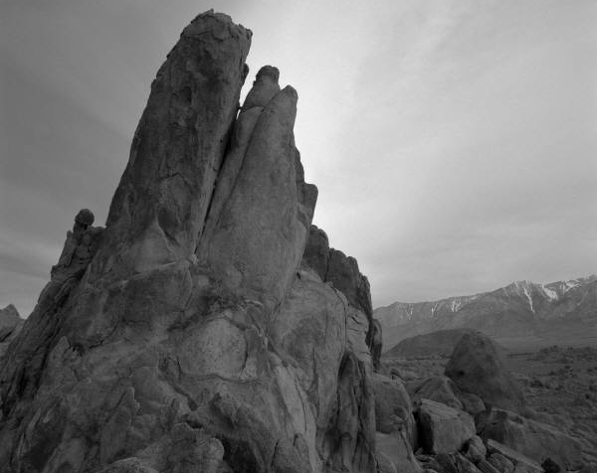
Building New Image Dataset
Photo description

Slide 8
Bounding Box Labels
Photo description

Slide 9
Creating TF records and config
First level bullet text, Verdana 24pt
Line spacing 0.95, before paragraph 12pt
Left justified
Sentence case
First level bullet color is accent1
Second level bullet Verdana 20pt
Line spacing 0.95, before paragraph 6pt
Third level
Third level
Fourth level

Slide 10
Training New Model
First level bullet text, Verdana 24pt
Line spacing 0.95, before paragraph 12pt
Left justified
Sentence case
First level bullet color is accent1
Second level bullet Verdana 20pt
Line spacing 0.95, before paragraph 6pt
Third level
Third level
Fourth level

Slide 11
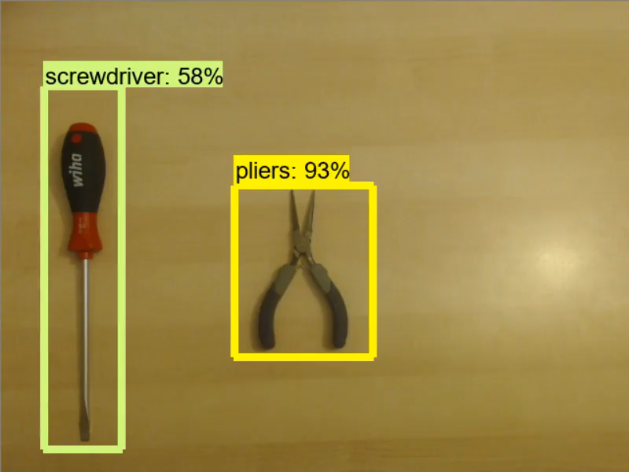
Real-time Detection (No Tracking)

Slide 12
Tracking
First level bullet text, Verdana 24pt
Line spacing 0.95, before paragraph 12pt
Left justified
Sentence case
First level bullet color is accent1
Second level bullet Verdana 20pt
Line spacing 0.95, before paragraph 6pt
Third level
Third level
Fourth level

Slide 13
Results
First level bullet text, Verdana 24pt
Line spacing 0.95, before paragraph 12pt
Left justified
Sentence case
First level bullet color is accent1
Second level bullet Verdana 20pt
Line spacing 0.95, before paragraph 6pt
Third level
Third level
Fourth level

Slide 14
Improvements
First level bullet text, Verdana 24pt
Line spacing 0.95, before paragraph 12pt
Left justified
Sentence case
First level bullet color is accent1
Second level bullet Verdana 20pt
Line spacing 0.95, before paragraph 6pt
Third level
Third level
Fourth level

Slide 15
Future Work
First level bullet text, Verdana 24pt
Line spacing 0.95, before paragraph 12pt
Left justified
Sentence case
First level bullet color is accent1
Second level bullet Verdana 20pt
Line spacing 0.95, before paragraph 6pt
Third level
Third level
Fourth level

Slide 16
Questions
First level bullet text, Verdana 24pt
Line spacing 0.95, before paragraph 12pt
Left justified
Sentence case
First level bullet color is accent1
Second level bullet Verdana 20pt
Line spacing 0.95, before paragraph 6pt
Third level
Third level
Fourth level

Slide 18
Layout: SectionDivider, Verdana Bold 40pt
Divider Subtext Verdana 28 pt

Slide 19
Layout: Title and Content Verdana Bold 32pt
First level bullet text, Verdana 24pt
Line spacing 0.95, before paragraph 12pt
Left justified
Sentence case
First level bullet color is accent1
Second level bullet Verdana 20pt
Line spacing 0.95, before paragraph 6pt
Third level
Third level
Fourth level

Slide 20
Layout: Two Content
First level bullet, Verdana 22pt
Line spacing 0.95, before paragraph 10pt
Left justified
Sentence case
First level bullet color is accent 1
Second level bullet
Third level
First level bullet, Verdana 22pt
Line spacing 0.95, before paragraph 10pt
Left justified
Sentence case
First level bullet color is accent 1
Second level bullet
Third level

Slide 21
Color Scheme
White–Background
R255 G255 B255
Accent 1
R171 G25 B45
Black
R0 G0 B0
Accent 2
R178 G183 B187
Red R171 G25 B45
Accent 3 R44 G106 B140
Grey
R109 G109 B109
Accent 4
R183 G160 B121
Accent 5 R70 G160 B220
Accent 6
R109 G109 B109

Slide 22
Default Settings
Theme Fonts:
Verdana (heading)
Verdana (body)
Drawing Style Default:
Sample
Sample
Sample
Text Box Default:
Verdana 16pt
Color: Black
Align: Center Line Spacing: Multiple .95 Space Before: 6pt
For labels only – use layout placeholders for bulleted lists
Line Style Default:

Slide 23
Default Table Style
Heading 1 | Heading 2 | Heading 3 | Heading 4 | Heading 5
Content | Content | Content | Content | Content
Content | Content | Content | Content | Content
Content | Content | Content | Content | Content
Content | Content | Content | Content | Content

Slide 24
Layout: PhotoCaption
Photo description

Slide 25
Layout: Content Column Chart Sample
Notes:
BEST PRACTICES:
Open Excel 2007 before creating charts in PowerPoint
Duplicate this slide and edit data

Slide 26
Layout: Two Content Column Chart Sample
First level bullet text
Line spacing 0.95, before paragraph 12pt
Left justified
Sentence case
First level bullet color is accent 2
Second bullet level
Line spacing 0.95, before paragraph 6pt
Notes:
BEST PRACTICES:
Open Excel 2007 before creating charts in PowerPoint
Duplicate this slide and edit data

Slide 27
Layout: Content Line Chart Sample
Notes:
BEST PRACTICES:
Open Excel 2007 before creating charts in PowerPoint
Duplicate this slide and edit data

Slide 28
Layout: Two Content Line Chart Sample
First level bullet text
Line spacing 0.95, before paragraph 12pt
Left justified
Sentence case
First level bullet color is accent 2
Second bullet level
Line spacing 0.95, before paragraph 6pt
Notes:
BEST PRACTICES:
Open Excel 2007 before creating charts in PowerPoint
Duplicate this slide and edit data

Slide 29
Layout: Content Pie Chart Sample
Notes:
BEST PRACTICES:
Open Excel 2007 before creating charts in PowerPoint
Duplicate this slide and edit data

Slide 30
Layout: Two Content Pie Chart Sample
First level bullet text
Line spacing 0.95, before paragraph 12pt
Left justified
Sentence case
First level bullet color is accent 2
Second bullet level
Line spacing 0.95, before paragraph 6pt
Notes:
BEST PRACTICES:
Open Excel 2007 before creating charts in PowerPoint
Duplicate this slide and edit data

